Slide 1
Oh dear, my sweet dear
What a blow
This is the end I fear
Oh why did you have to go?

Slide 2

We were such good friends you and I
We traveled from here to there

Slide 3
From village to city, I tipped you with pride

Slide 4
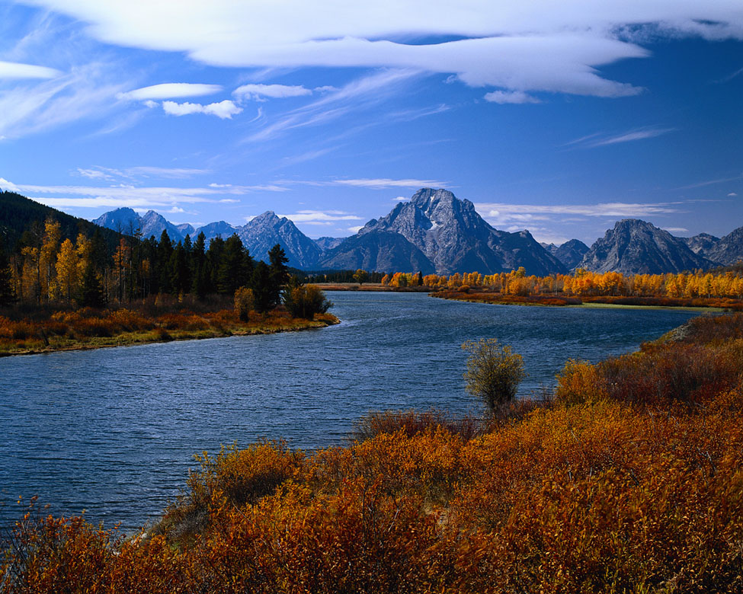
Mountain to river, oh with such flair

Slide 5
Who would have thought that you and I would ride the tides?

Slide 6

But now I feel so bare

Slide 7
I guess its time to say goodbye

Slide 8
Im off to take care of my hair
And make another smart buy…

Slide 9
And with that
Hello new hat!

