Slide 1
WILL HE BE MY KNIGHT?
Understanding & pronouncing kn & wr
Ohr Olivkovich

Slide 2
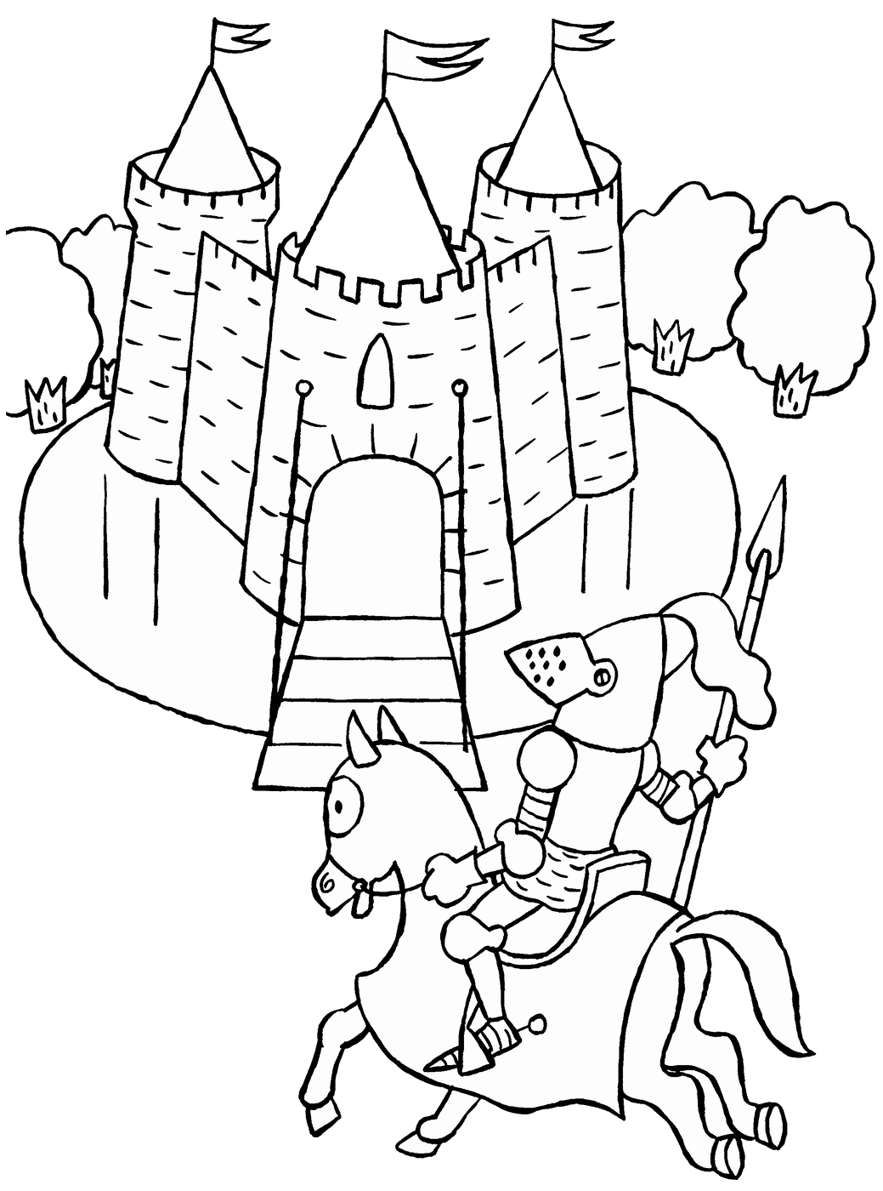
Into my room comes a knight
In he comes –
not knocking,
In he comes –
just knob wrecking!

Slide 3
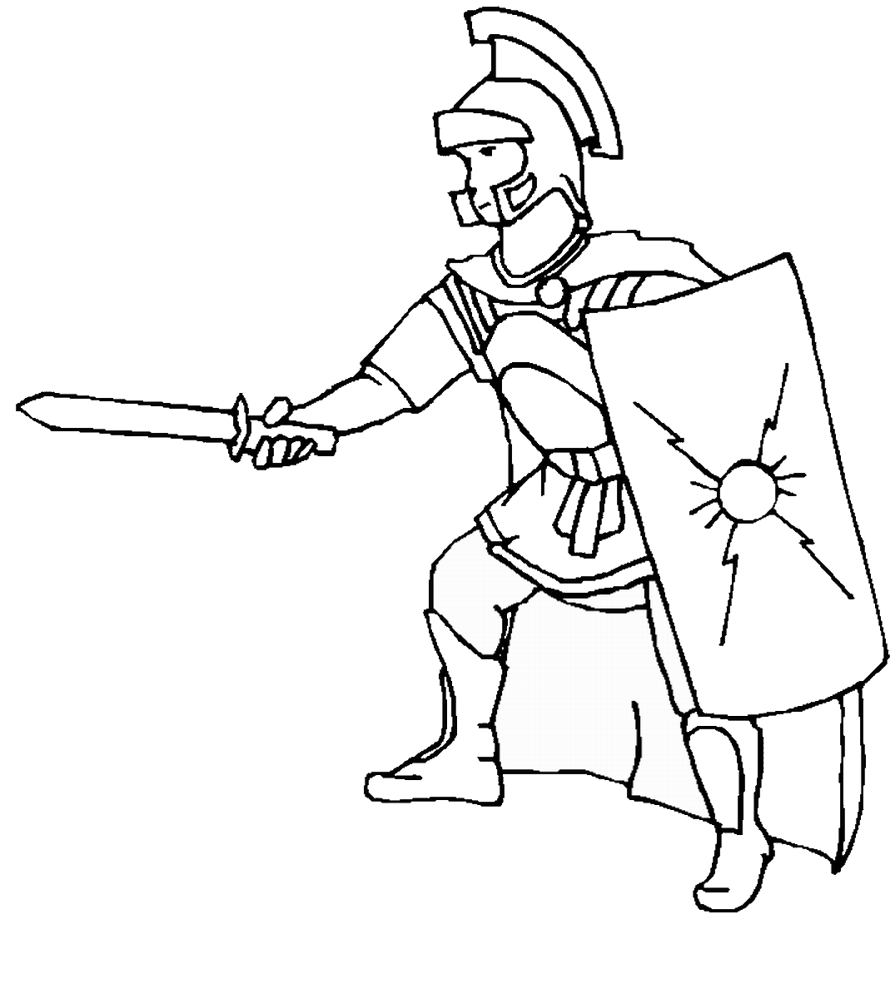
Into my room comes the knight,
In he comes –
carrying a knife and a wrench,
In he comes –
what a wretch!

Slide 4
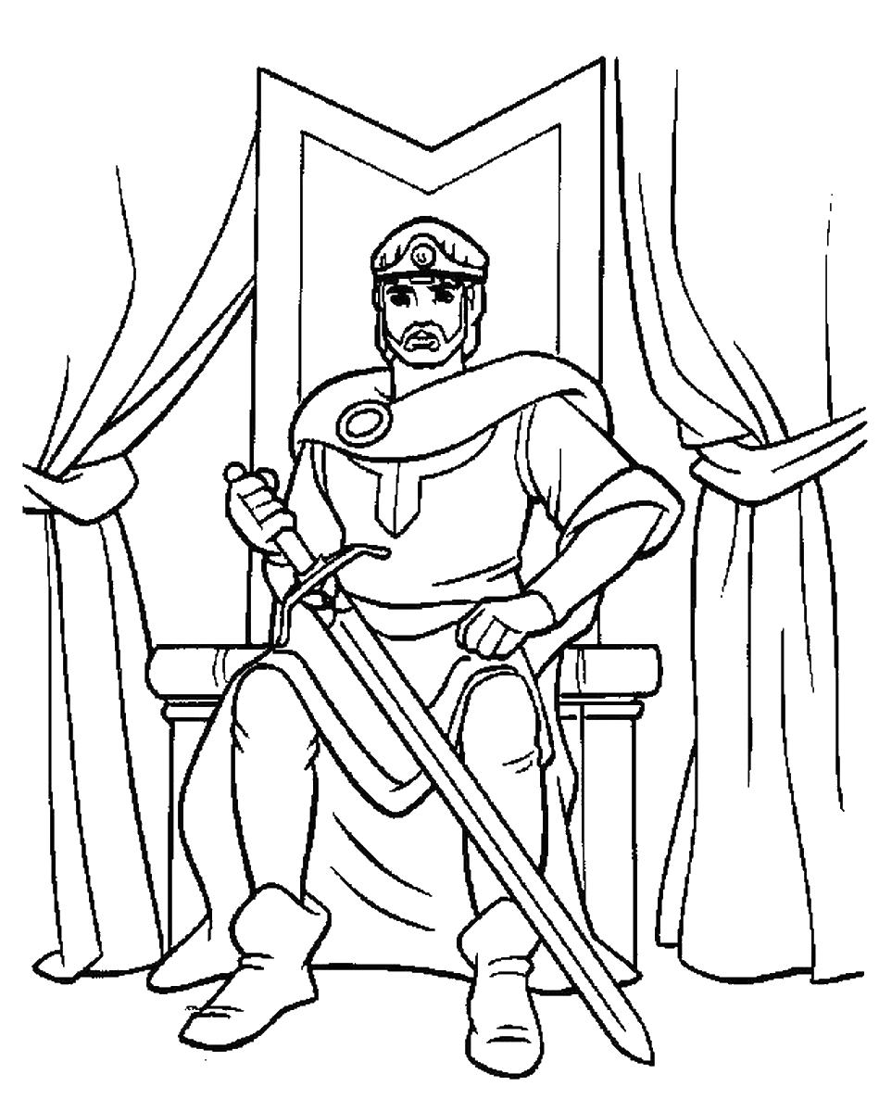
Into my room comes the knight,
In he comes - wrapped with his delight,
In he comes - kneeling with all his might!

Slide 5
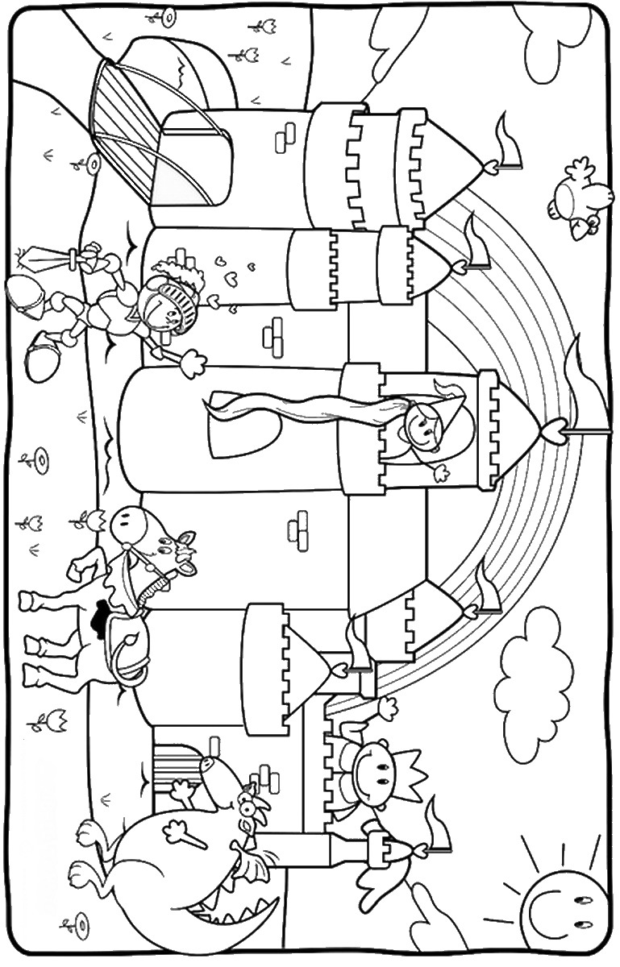
But I say - he is not right!
I say - he will not be my knight!
I say - the knot will not be tied tonight!

