Slide 1
The Little Elephant and The Spider Web Thread
By Sara Celiberti

Slide 2
One little elephant was swinging on a spider web thread…
She loved the game!
She went and called another little elephant…

Slide 3
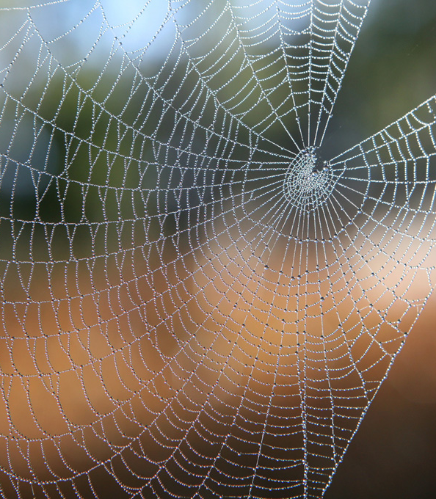
Two little elephants were swinging on a spider web thread…
They loved the game!
They went and called another little elephant…

Slide 4
Three little elephants were swinging on a spider web thread…
They loved the game!
They went and called another little elephant…

Slide 5
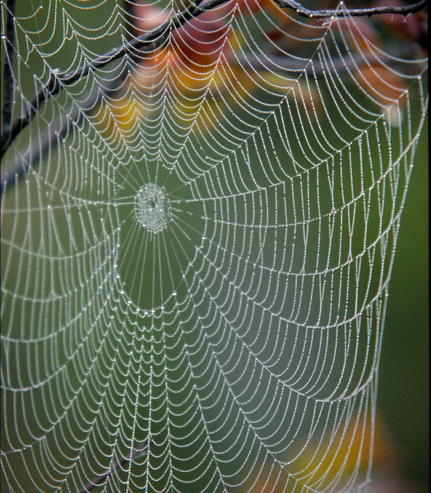
Four little elephants were swinging on a spider web thread…
One of them got bored of it…
He left, and then there were only three little elephants…

Slide 6
Three little elephants were swinging on a spider web thread…
One of them got bored of it…
She left, and then there were only two little elephants…

Slide 7
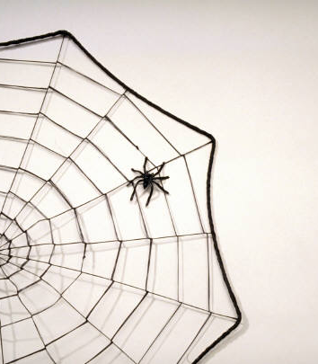
Two little elephants were swinging on a spider web thread
One of them got bored of it…
He left, and then there was only one little elephant…

Slide 8
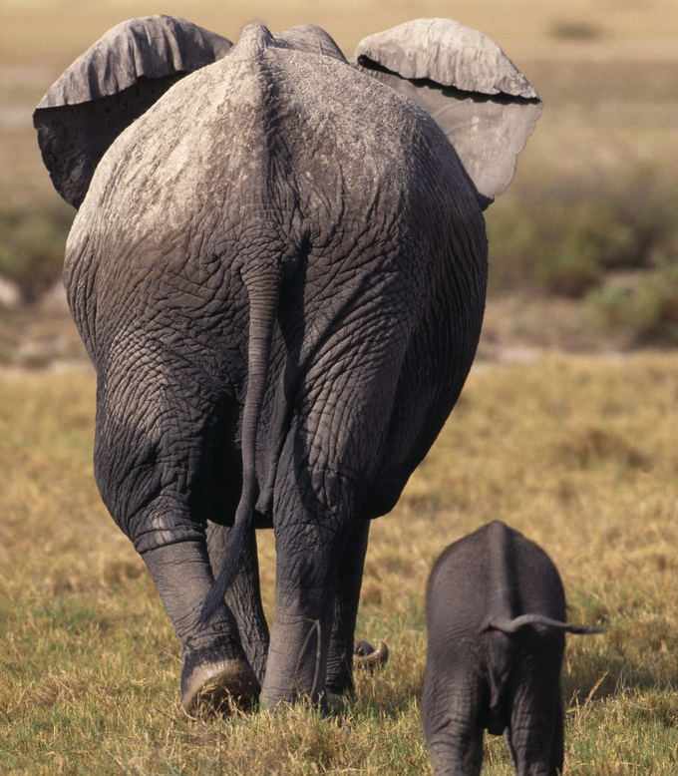
One little elephant was swinging on a spider web thread…
The thread broke and she fell down!
The game was over… the little elephant ran home to her mummy elephant.

