Slide 1
The knight knows

Slide 2
The knight knows
When he sneezes, he is wrong
When he falls on his knees, he breaks the floor

Slide 3
The knight knows
He is willing to fight
But when he wrestles,
he takes a big fall

Slide 4
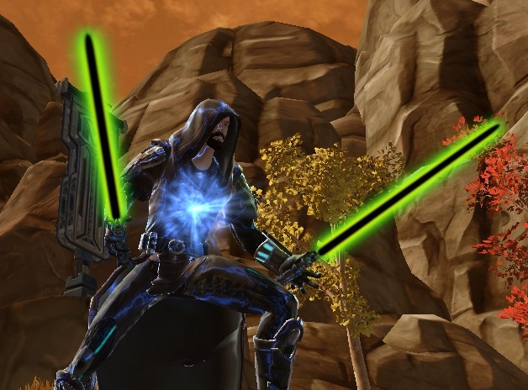
The knight knows
He is bright
But his sight is not right

Slide 5
The knight knows
Now it is night,
so he lays down in bed and snores

Slide 6
When the sun is high in the sky
He sits in bed and writes
Since he knows
He might loss his mind

Slide 7
Rationale
/Igh/ combination of letters that make a certain sound
Rhythm –easy to remember
/kn/ and /wr/- letter combinations where you do not pronounce the first letter
Chunks of words

