Slide 1
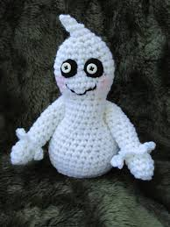
The Little Ghost
Written by Buyskikh Tania

Slide 2

The father ghost said
To his little son Egghead
“My little ghost, you know,
The winter is fine below
Please, go to play in the snow!”

Slide 3

“ But, father, how can I go?
The winds on me will blow!”

Slide 4
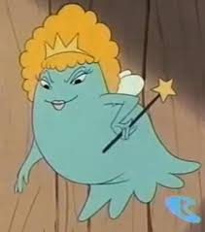
The mother ghost said
To her little son Egghead
“ My little ghost, you know,
The weather is not bad below
Please, go to play in the snow!”

Slide 5

“But, mother, how can I go?
The winds on me will blow!”

Slide 6
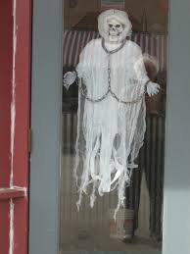
Then, grandmother ghost said
To the family of little Egghead
“ My dear ghosts, you know,
Leave an Egghead alone
And let him stay at home!”

Slide 7
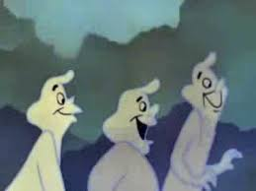
So, they went to play
Together in the snow

Slide 8

But little ghost stayed at home
And he felt so alone!!!!!

