Slide 1

I once saw a monster

Slide 2
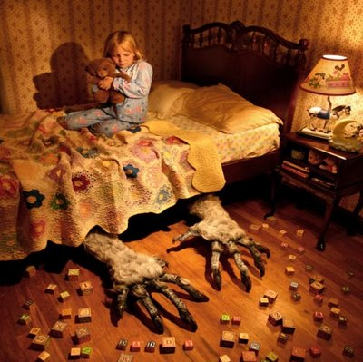
I once saw a monster under my bed

Slide 3
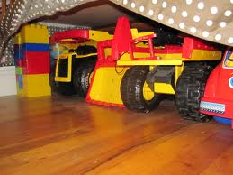
But when my Dad turned on the light
It turned into my toy truck

Slide 4
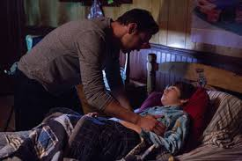
I told him that's the monster
But he said:
"Hush now son, it's nothing.
Good night, sleep tight"

Slide 5
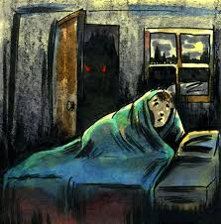
I once saw a monster hiding in my closet

Slide 6
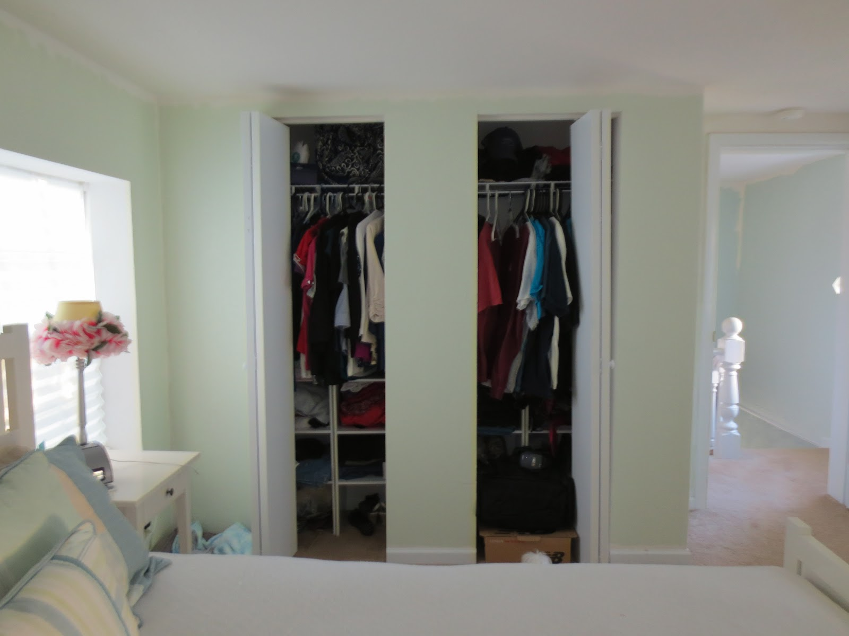
But when my Mom turned on the light
It turned into a hanger with clothes

Slide 7
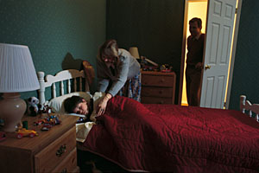
I told her that's the monster
But she said:
"Hush now son, it's nothing.
Good night, sleep tight"

Slide 8
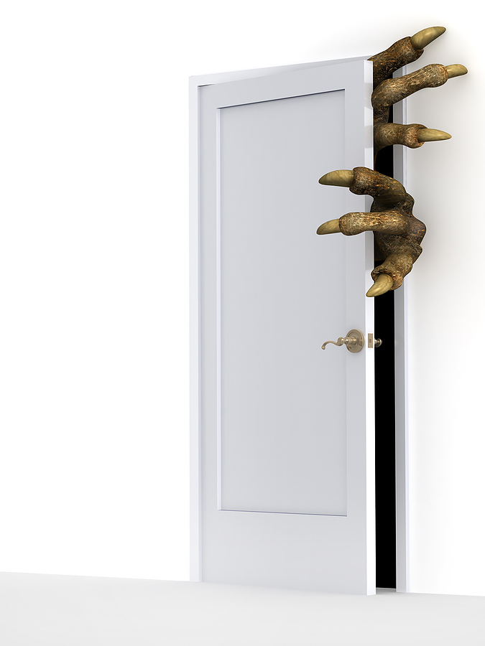
I once saw a monster hiding in the shadows behind my door

Slide 9
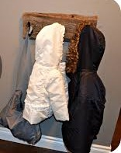
But when my sister turned on the light
It turned into my coat

Slide 10
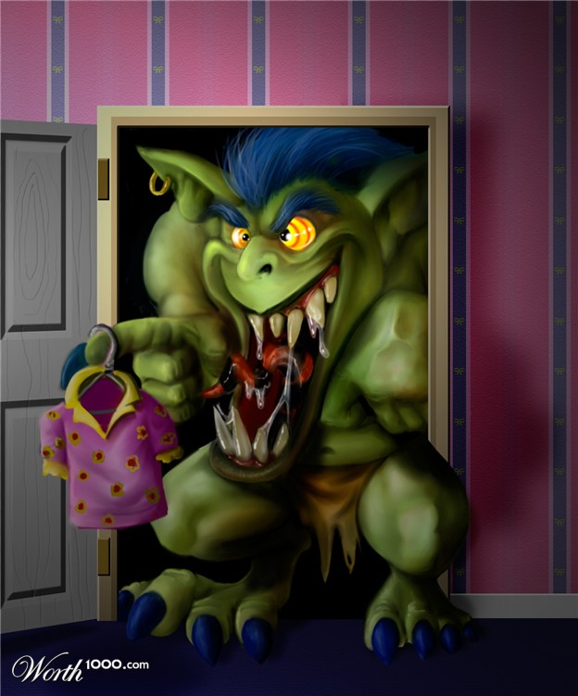
I told her that's the monster
So she turned off the lights
And there from the shadows
The monster came out

Slide 11
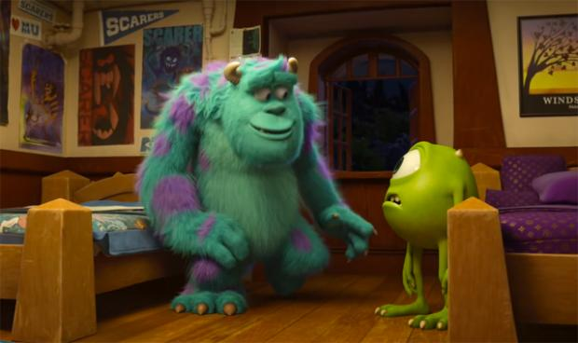
I once saw a monster standing in my room

Slide 12
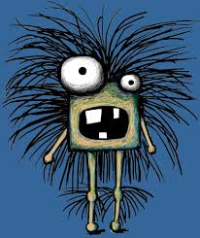
It was scary, big and hairy
I was scared and wanted it to leave

Slide 13
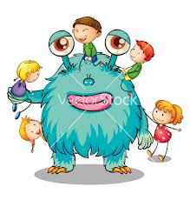
But then he said he was lonely
And was looking for a friend
We played knights and kings, and rescued the princess
We didn't sleep all night

