Slide 1
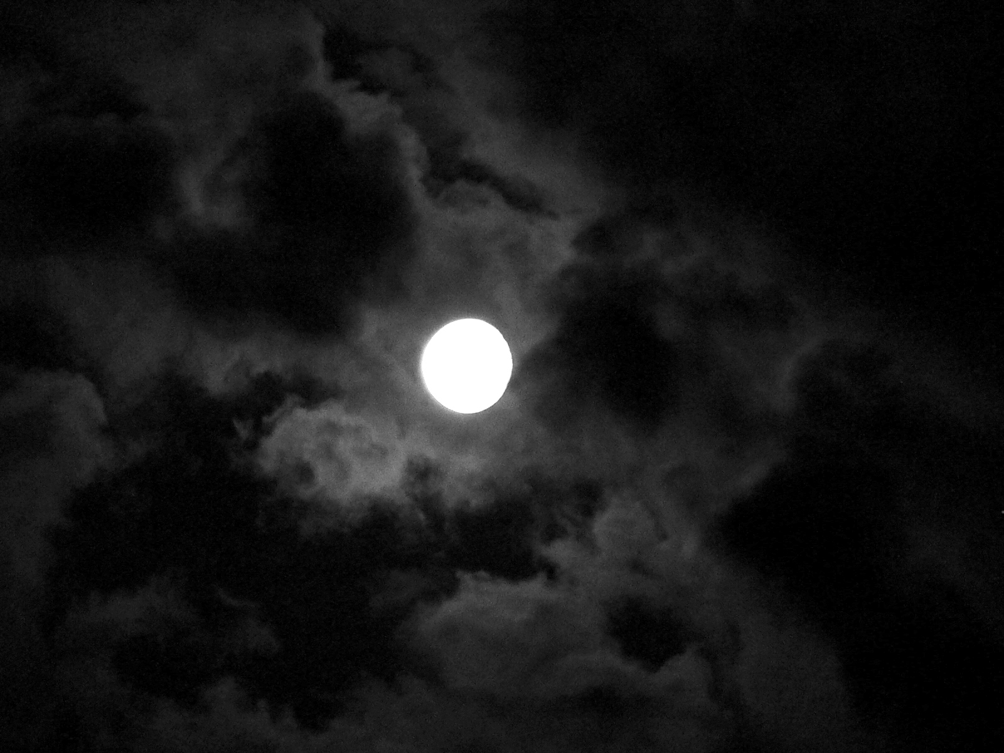
Last night, when lights went off
She thought he brought her flowers
But actually he bought her books.her

Slide 2
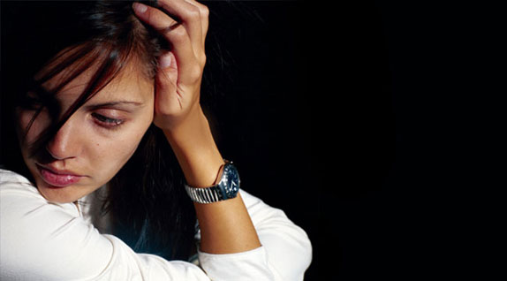
She didn't want to pick a fight
But why ? She wondered

Slide 3
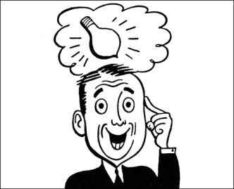
As it turned out, he thought
She is not too bright
And books might light her mind

Slide 4
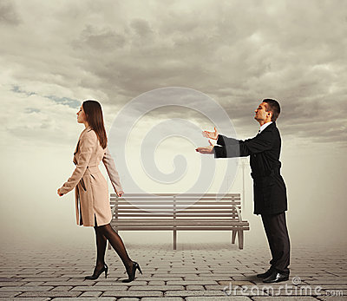
So now he is not her handsome knight
Tonight he'll sleep alone
So now he is not her handsome knight
Tonight he'll sleep alone

Slide 5
In this particular text, the pupils can learn that “gh” is silent. Pupils can see repeatedly “gh” silent in various words

