Slide 1
If you… you will
Written by: Libat Kitai

Slide 2
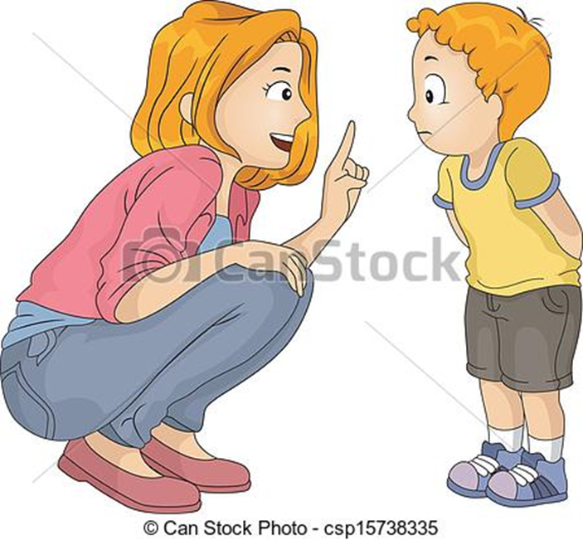
When I was young, my mother told me…

Slide 3

If you eat, you will grow tall…

Slide 4
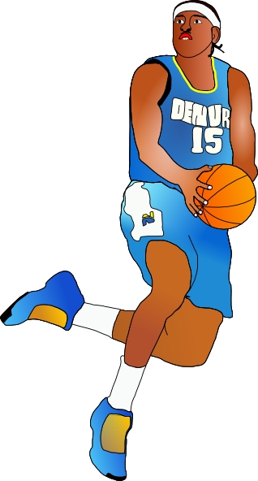
If you grow tall, you will play basketball

Slide 5
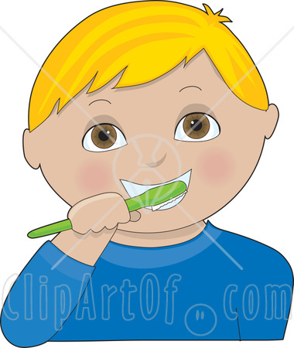
If you brush your teeth, you won’t be smelly…

Slide 6
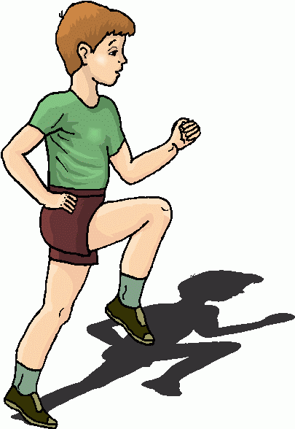
If you exercise, you will be healthy

Slide 7

When I grew up, my mother kept saying…

Slide 8
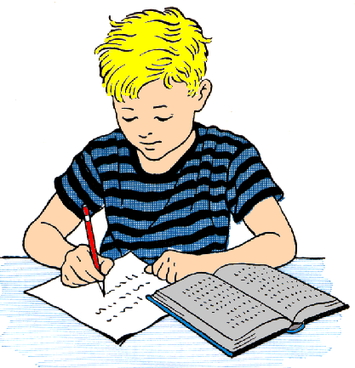
If you learn, you will be wise…

Slide 9

If you practice, you will win first prize

Slide 10
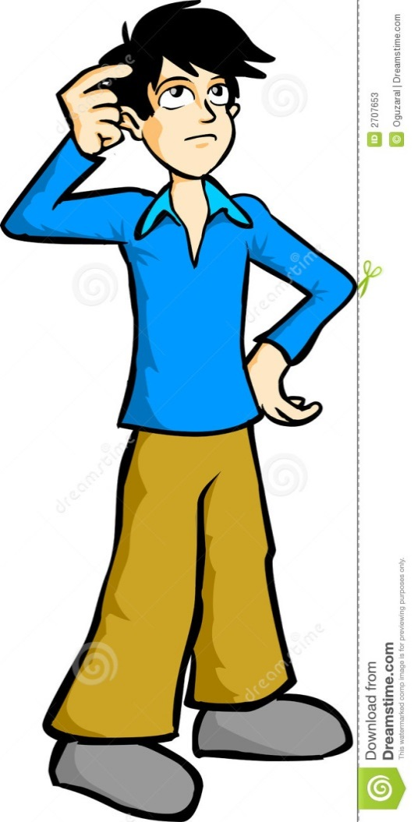

If you never try, you will never know

Slide 11
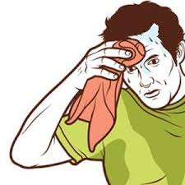
If you make an effort, it will show

Slide 12
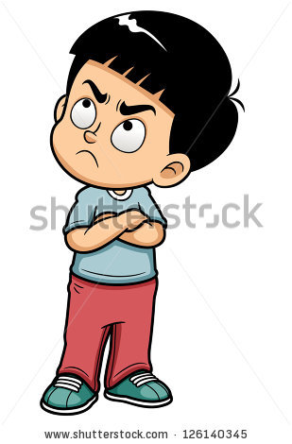
When I was young, I hated “if you”…

Slide 13
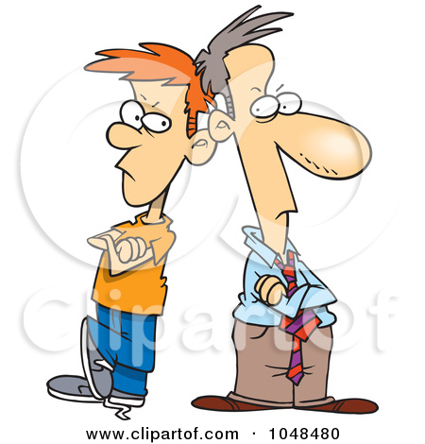
Now I’m a parent, and I say it too…

