Slide 1
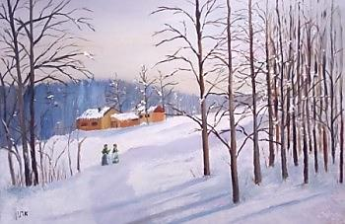
Elana Koren
The Snow

Slide 2
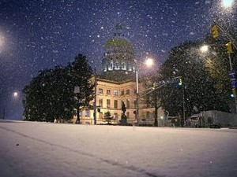
I sat in my room.
I sat by the window.
I sat and listened to the wind blow.
I sat and watched the snow falling down.

Slide 3
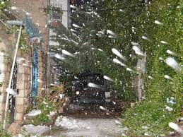
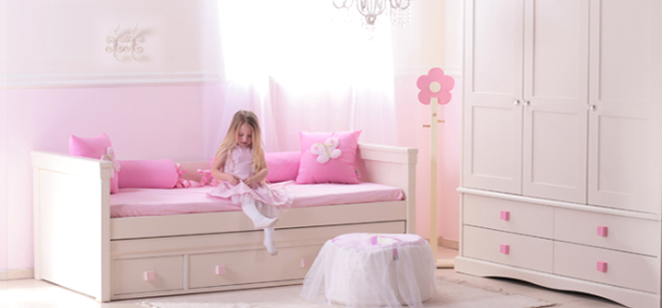
I sat inside while the storm was outside.
I sat in my warm room on a cold dark night.
I sat in my room and I felt delight.

Slide 4

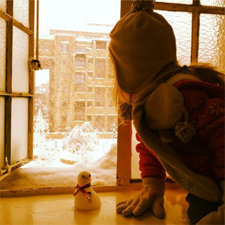
I could see the snow in the morning.
I could see the snow from my window.
I could see it was white and bright.
I couldn't wait to start a snow ball fight.
I could see the snow.
I could see it glow.

Slide 5
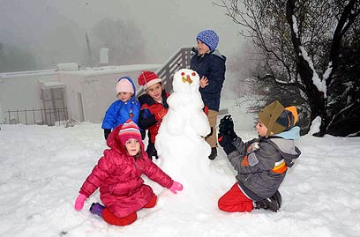
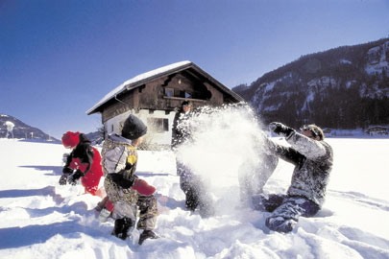
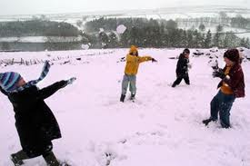
I went outside to build a snowman.
I went outside to play with the snow,
which was soft, white and light.
I went outside full of joy and delight.
I went outside to play with the children
and start a snow ball fight.

Slide 6
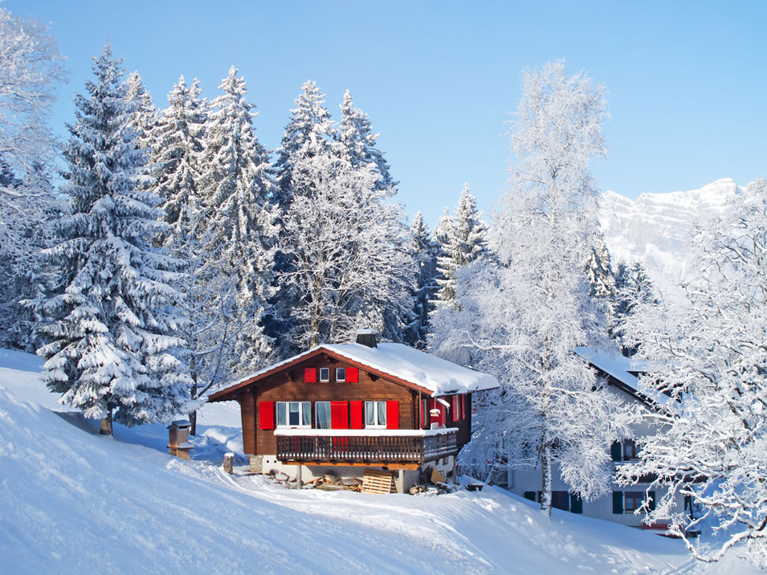
The End

Slide 7
The snow (by Elana Koren)
This is a booklet for emerging readers. The text includes features that can be used to work on both global reading and phonics.
For global reading, it has repetition of phrases (in the beginning of the sentence).
In paragraphs 1 and 2, the student encounters the phrase "I sat" 7 times. In paragraph 2, the student reads the phrase "I sat in" in the beginning of two sentences.
In paragraph 3, most of the sentences begin with the phrase "I could see".
In paragraph 4, every sentence begins with the phrase "I went outside".
Therefore, when the students read the beginning of the sentences they practice global reading, which helps them develop speed and automaticity in reading.
For phonics, the text has rhyme patterns that can be used to teach the sounds "-ow", "-ight", and about magic e. It is important to teach that sometimes the same sound may be represented by different spellings.
In paragraph 1: window, blow
In paragraph 2: night, delight
In paragraph 3: white, bright, fight (white has a different spelling)
snow, glow
In paragraph 4: light, delight, fight
Practicing the reading of those patterns will help students develop speed and automaticity in reading.
On every page, there are pictures that illustrate the text and help understanding it. The pictures can also be used in order to tell the story using words and phrases from the text.

